Slide 1
PROJECT REPORT PREPARATION
Submitted by- Mrs. Reena Rani

Slide 2
What is actually a Project Report?
The document which contains the required details like the personal bio-data of the entrepreneur, the product to be manufactured, its design, manufacturing process, raw materials, machines and equipments required, staff needed, the amount of money required, the source of finance, cost of goods to be produced, market demand of the product and the likely profits anticipated etc. is called a project report.
Project report is a written statement of what an entrepreneur proposes to take up. It is well evolved course of action devised to achieve the specified objective within a specified period of time.

Slide 3
Why do we need a Project report?
An objective without a plan is dream. The project report is of great significance for an entrepreneur. The project report serves the following purposes:
Project report describes the direction the enterprise is going on, what its goals are, where it wants to be and how it is going to get there.
It helps the entrepreneur in getting provisional registration of the project from the district industries centre.
It helps in allotment of industrial plot or shed for the project.
It helps the entrepreneur in obtaining working capital loan or term loans from banks.
It helps in securing supply of scarce raw materials.

Slide 4
Contents of a Project Report
Objective and scope of the report
Promoter’s profile: Such as family background, Educational qualifications, past experience of service, business or industry, project related experience etc.
Location: Exact location of the project, lease or freehold, locational advantages etc.
Land and building: Land area, constructed area, type of construction, cost of construction, detailed plans and estimates along with plant layout.
Plant and machinery: Details of machinery and equipments required, electric loads, capacity, suppliers, cost, various alternatives available etc.
Production process: Details of production process.
Other utilities: Requirement of water, power, steam, compressed air requirements, sources of these utilities etc.
Raw material: Requirements of raw materials, sources, prices, properties of raw material.

Slide 5
PRELIMINARY PROJECT REPORT(P.P.R)
A preliminary project report is a brief summary of a project describing the expected inputs and outputs like finance, manpower, machinery, materials, technology, expenses, production, sales and profits etc. of a project before the project is actually implemented.

Slide 6
Detailed Project Report
Detailed project report is nothing but a detailed elaboration of each and every information and estimates mentioned in a preliminary project report while preparing a detailed project report the entrepreneur may take the help of experts to do the job.

Slide 7
Project Appraisal
The exercise of project appraisal simply means the assessment of a project in terms of its economic, technical, social and financial viability. Simply speaking, project appraisal means the assessment of a project. Hence, project appraisal is a multi-dimensional analysis of the project i.e. a complete scanning of the project.

Slide 8
Stages of Project Appraisal
Economical Analysis
Financial Analysis
Technical Feasibility
Managerial Competence
Market/ Commercial Analysis

Slide 9
1. ECONOMICAL ANALYSIS

Slide 10
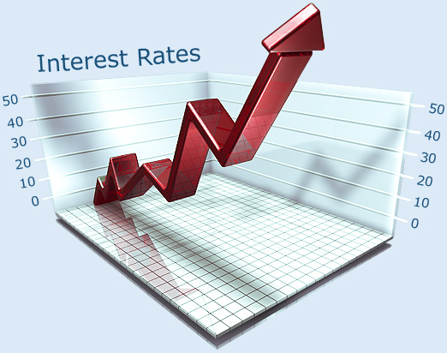
The economic aspects of appraisal are fundamental as they logically precede all other aspects because the bank will not finance a project unless it stands assured that the project represents a high priority use of a region’s resources.

Slide 11
2. Financial Analysis

Slide 12
Finance is one of the most important pre-requisites to establish an enterprise. It is finance only that facilitates an entrepreneur to bring together the labour of one, machine of another and raw materials of yet another to combine them to produce goods.
In any project, capital is invested in two types of expenditures:
Fixed capital
Recurring expenditure

Slide 13
3. Technical Feasibility

Slide 14
While making project appraisal, the technical feasibility of the project also need to be taken into consideration.
While assessing the technical feasibility of the project the following aspects need to be covered in the report :
Process Technology
Economic size of the project
Technical know-how the consultancy

Slide 15
4. Managerial Competence

Slide 16
Managerial ability or competence plays an important role in making an enterprise a success or otherwise. Strictly speaking, in the absence of managerial competence, the projects which are otherwise feasible may fail.

Slide 18
5. Market /Commercial Analysis

Slide 19
Before the production actually starts the entrepreneur needs to anticipate the possible market for the production. He has to anticipate who will be the possible customers for this product and where an when his product will be sold.

Slide 21
THANK YOU AND HAVE A NICE DAY

